Slide 1


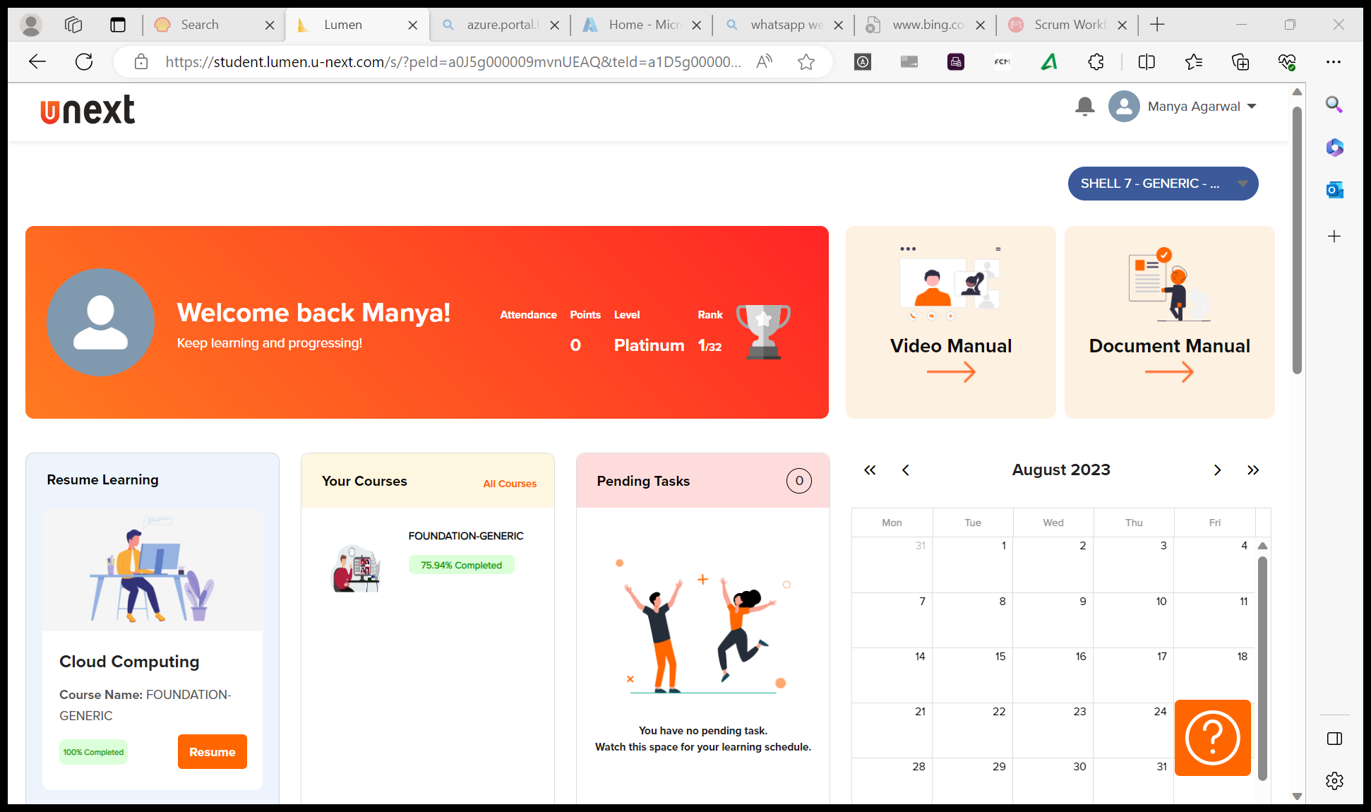
Journey Presentation
Submitted By:
Manya Agarwal
Employee No. : 654801

Slide 2
Journey Presentation Week-6

Slide 3
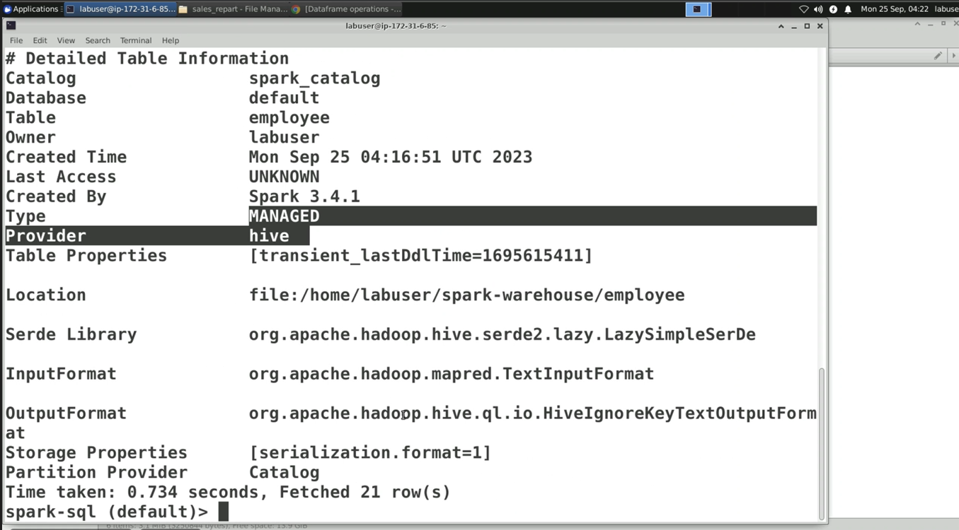
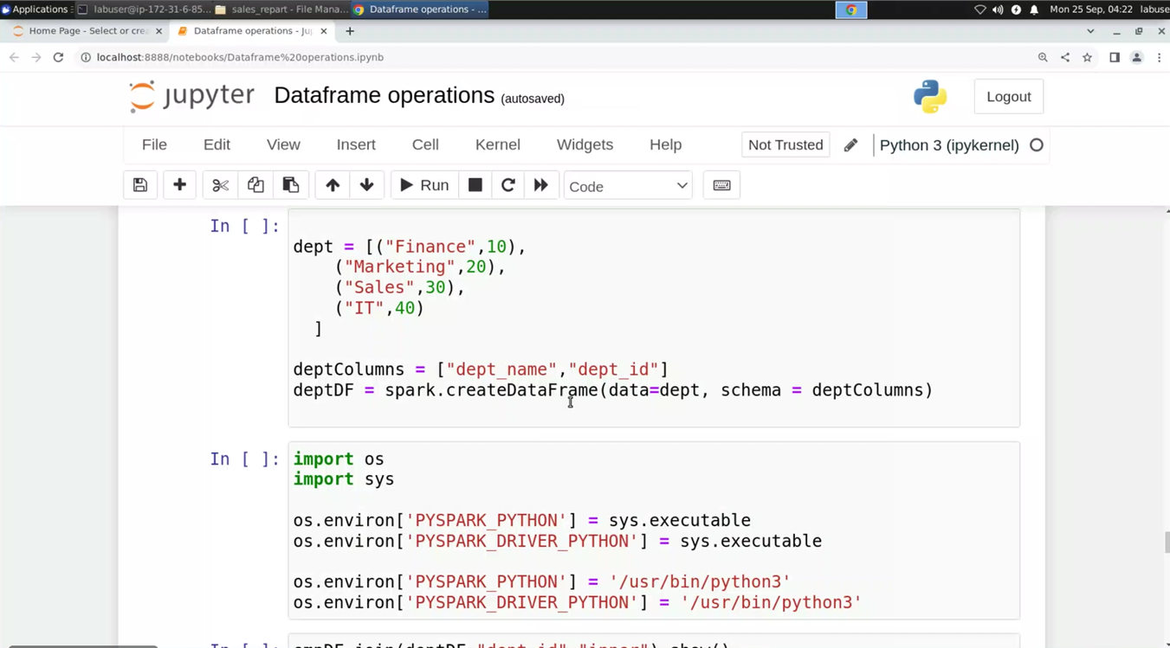
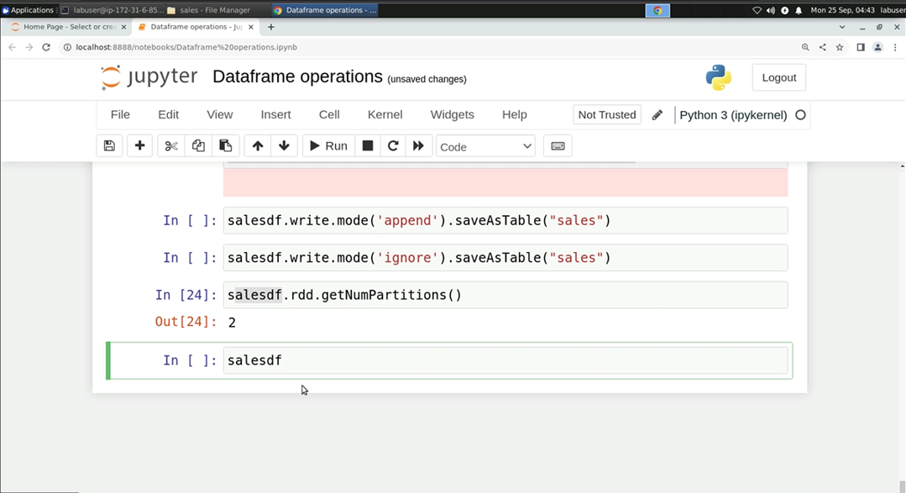
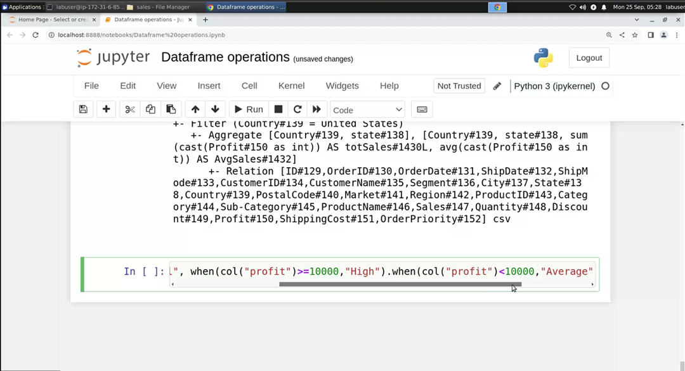
25-Sep-23 (Monday) – PySpark Online Session

Slide 4
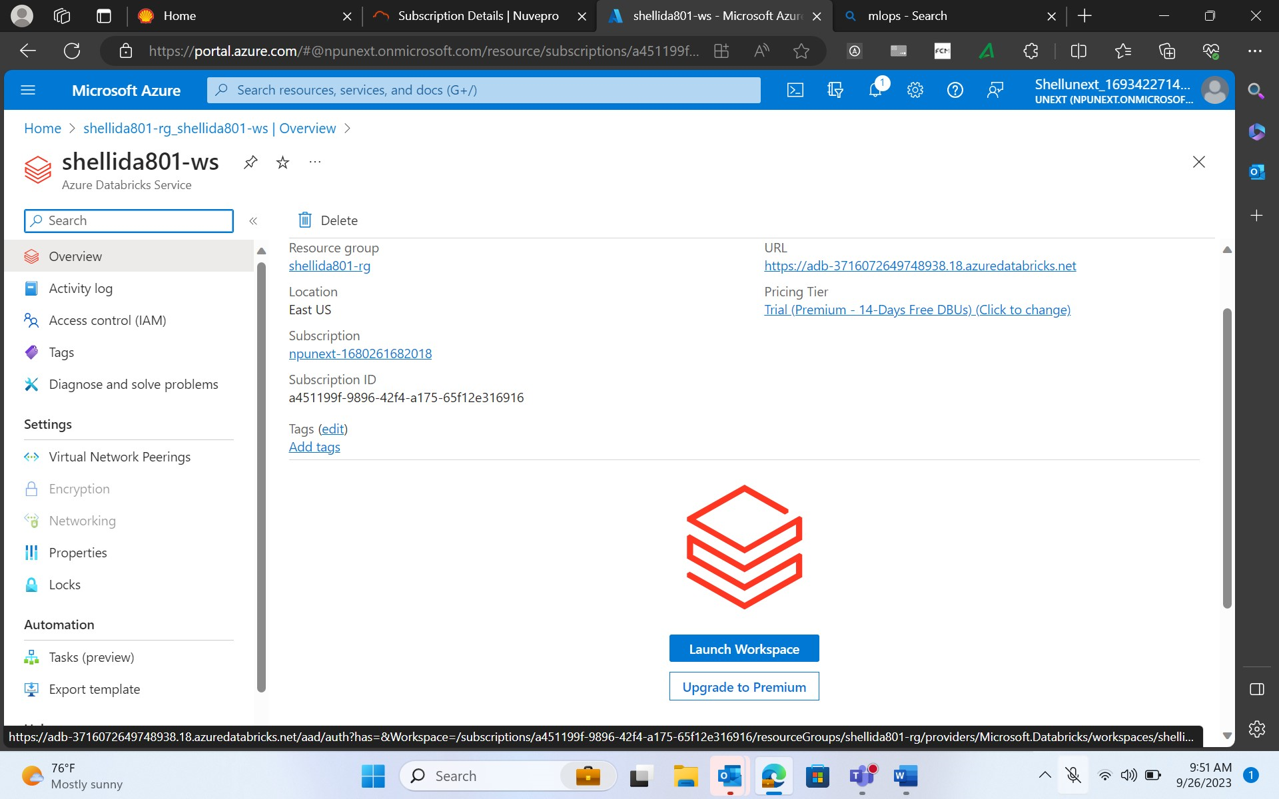
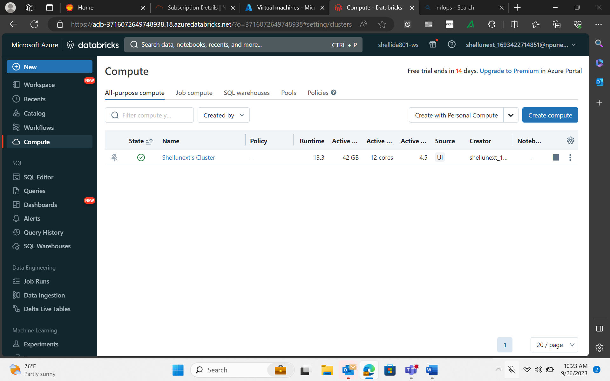
26-Sep-23 (Tuesday) – Databricks Online Session
Databricks - cloud platform supported in AWS Azure and GCP. Databricks is commercial
Databricks CLUSTER :
Al purpose compute → any processing, jobs, notebook
Job compute → specific to particular job, terminates once the job completes
Shared –pool →
Sql warehouse

Slide 5
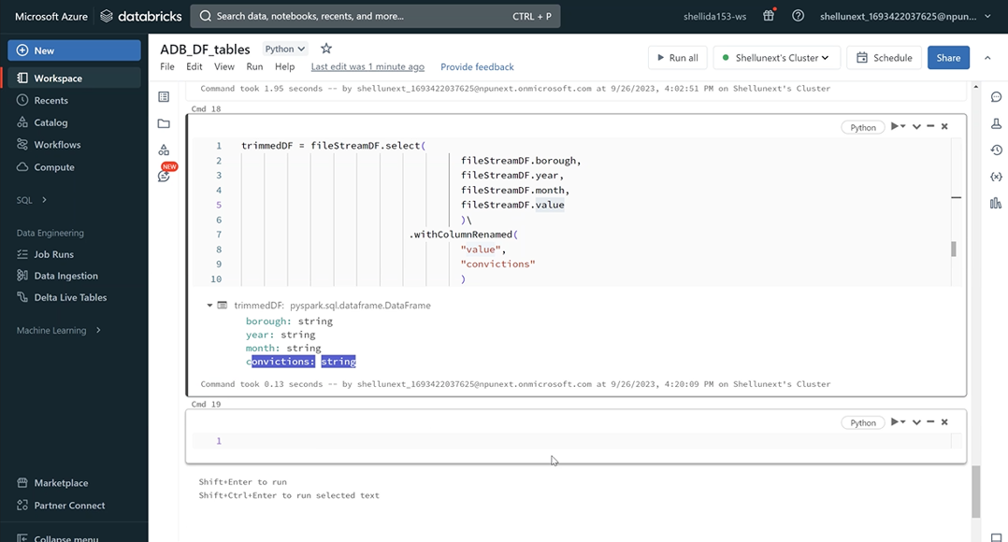
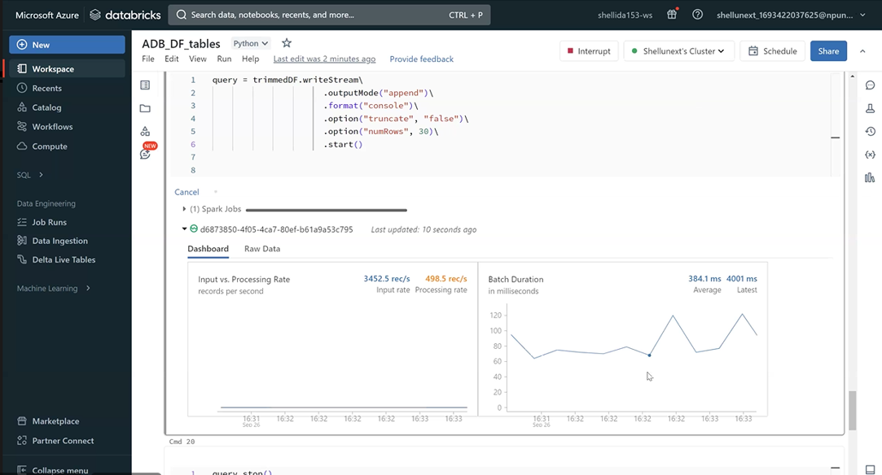
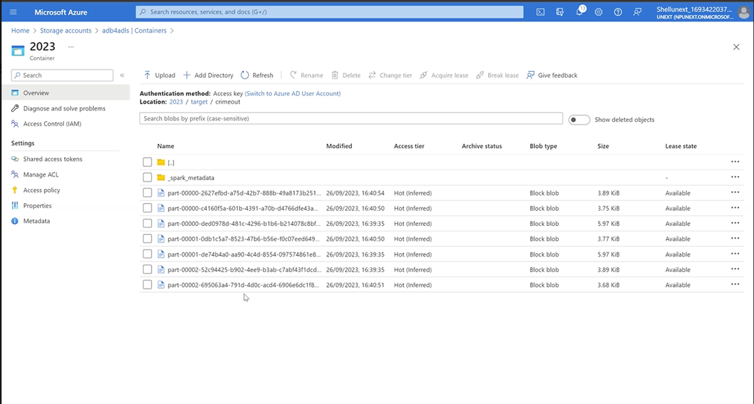
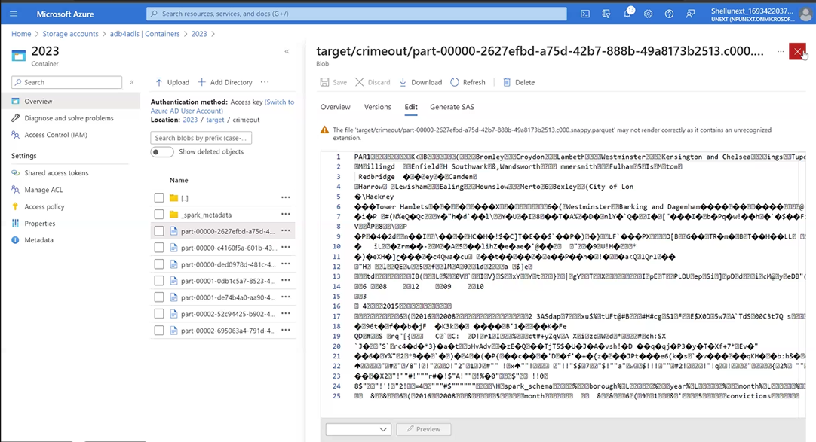
26-Sep-23 (Tuesday) – Databricks Online Session

Slide 6
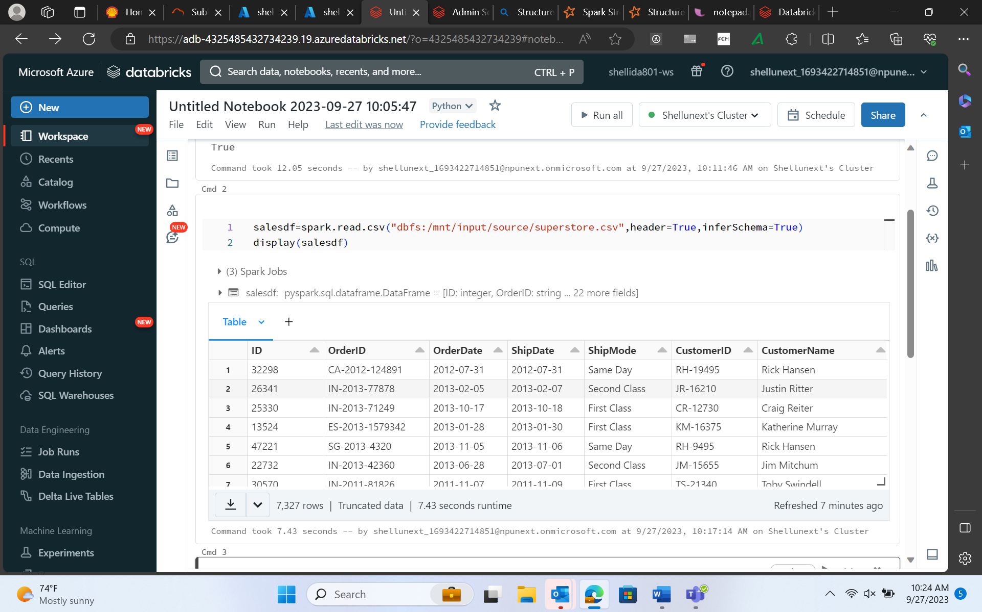
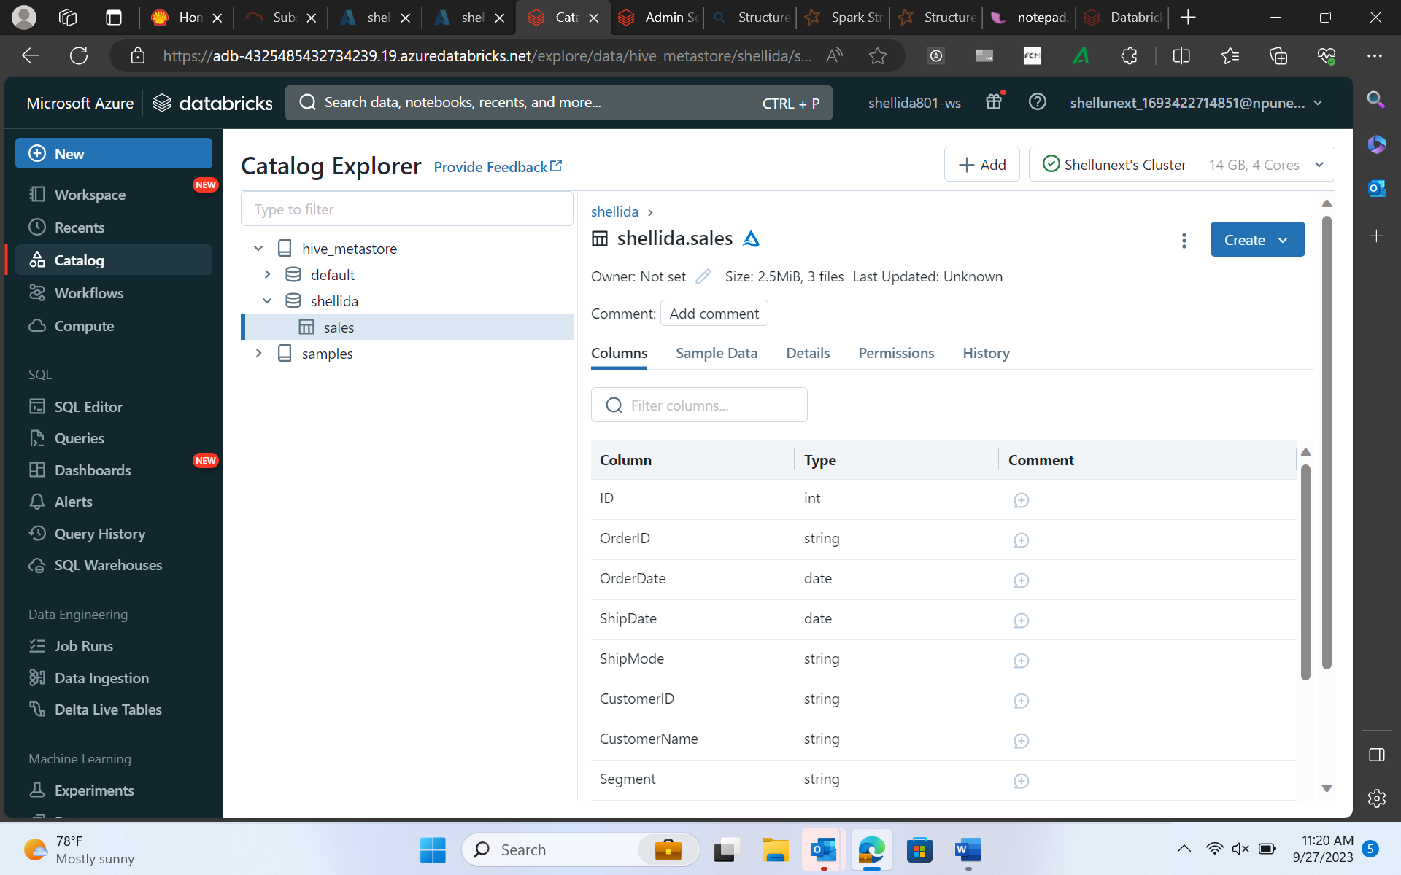
27-Sep-23 (Wednesday) – Databricks
Output modes → complete - entire primes, append – only new primes , update – compare the prev values
E.g. → Wordcount →
Complete, append, update
1st entry → a,a,b,c a-2,b-1,c-1 a-2,b-1,c-1 a-2,b-1,c-1
2nd entry → a,c a-3, b-1, c-2 a-1, c-1 a-3, c-2
3rd entry → b,b,c a-3,b-3,c-3 b-2,c-1 b-3, c-3
4th entry → a,a,d a-5, b-3,c-3,d-1 a-2,d-1 a-5, d-1

Slide 7
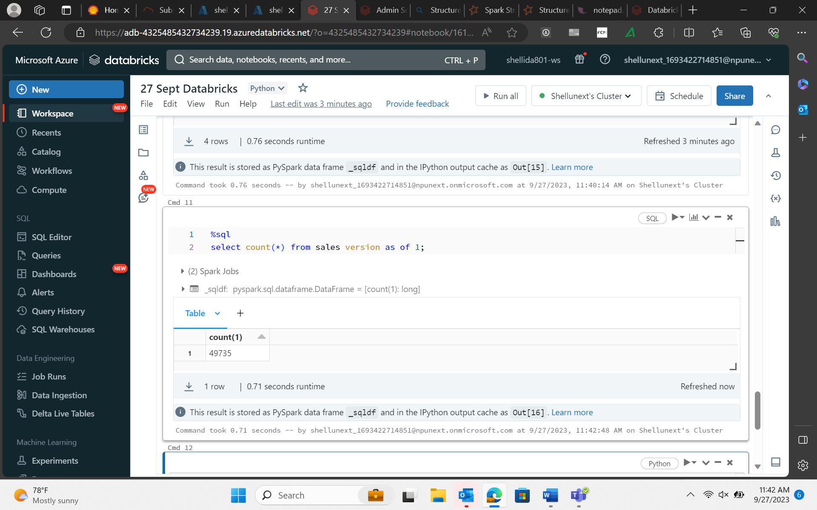
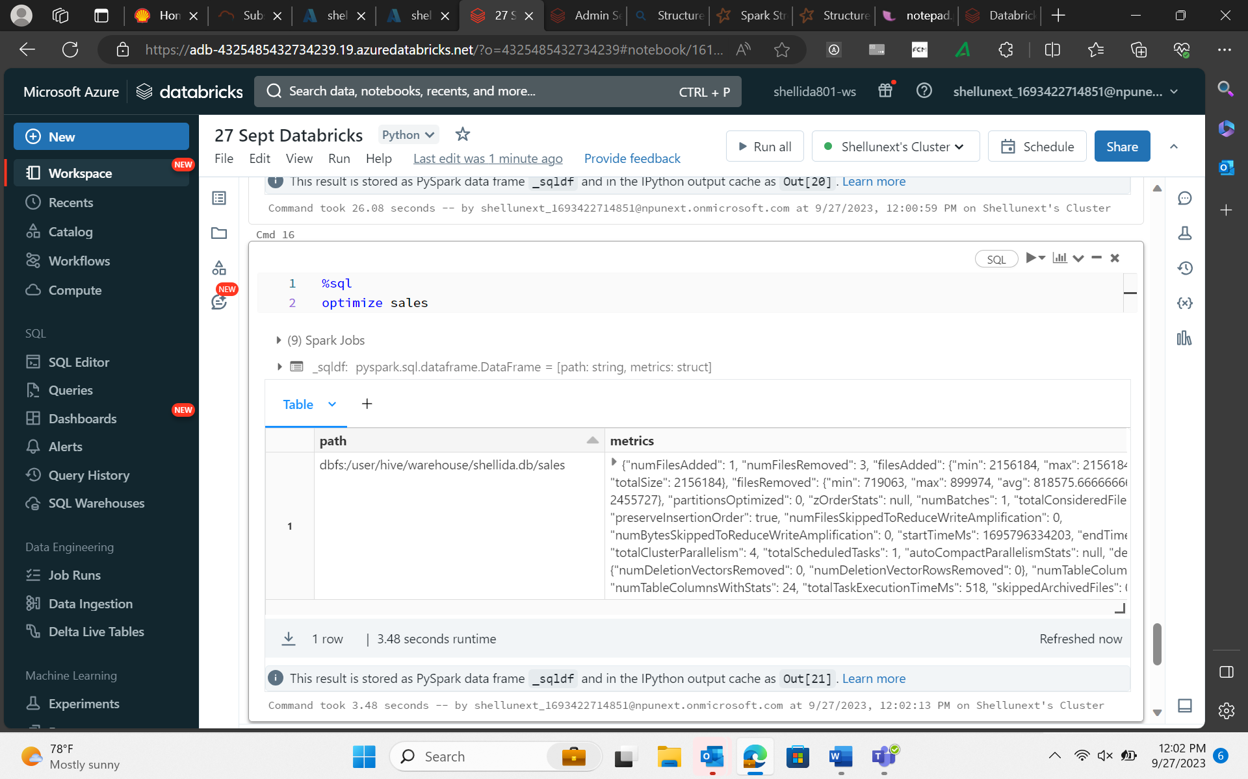
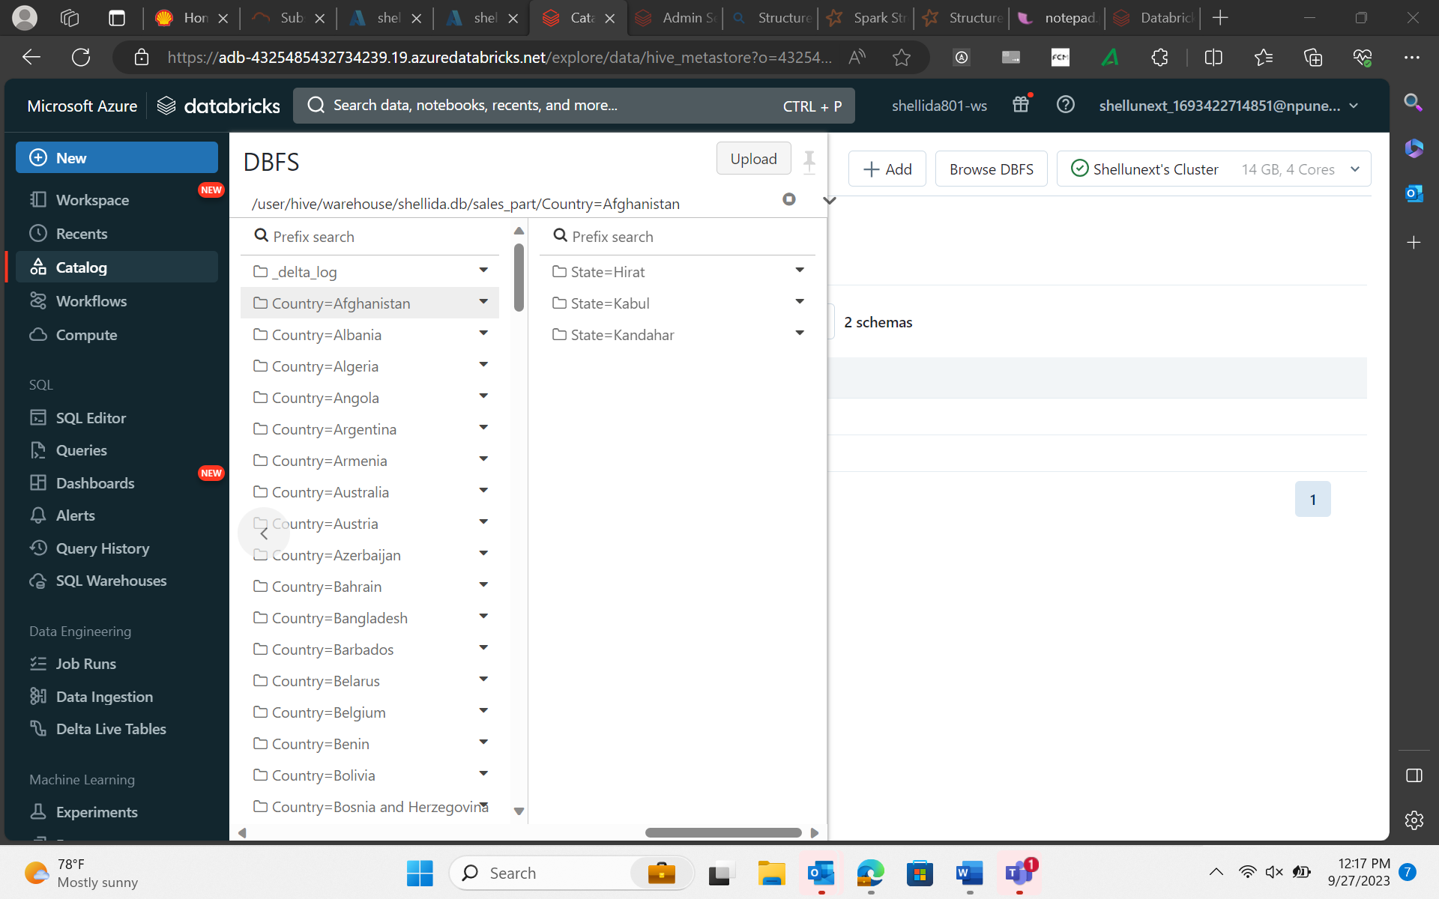

27-Sep-23 (Wednesday) – Databricks

Slide 8
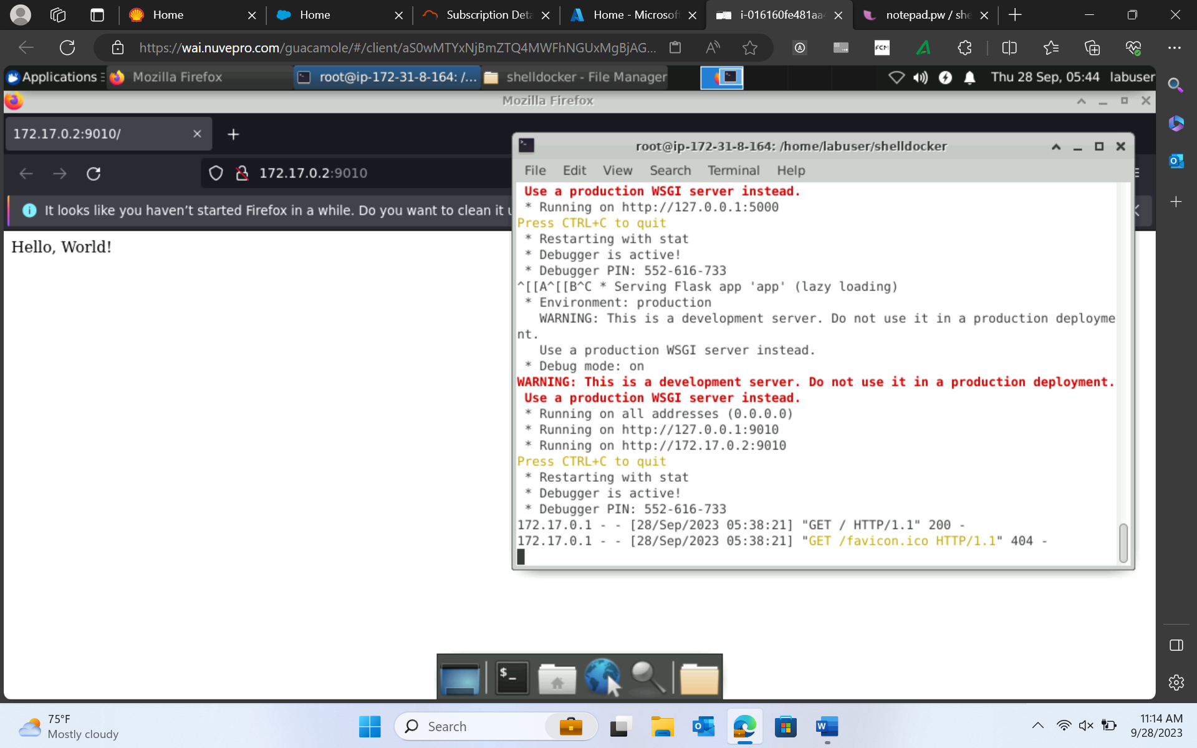
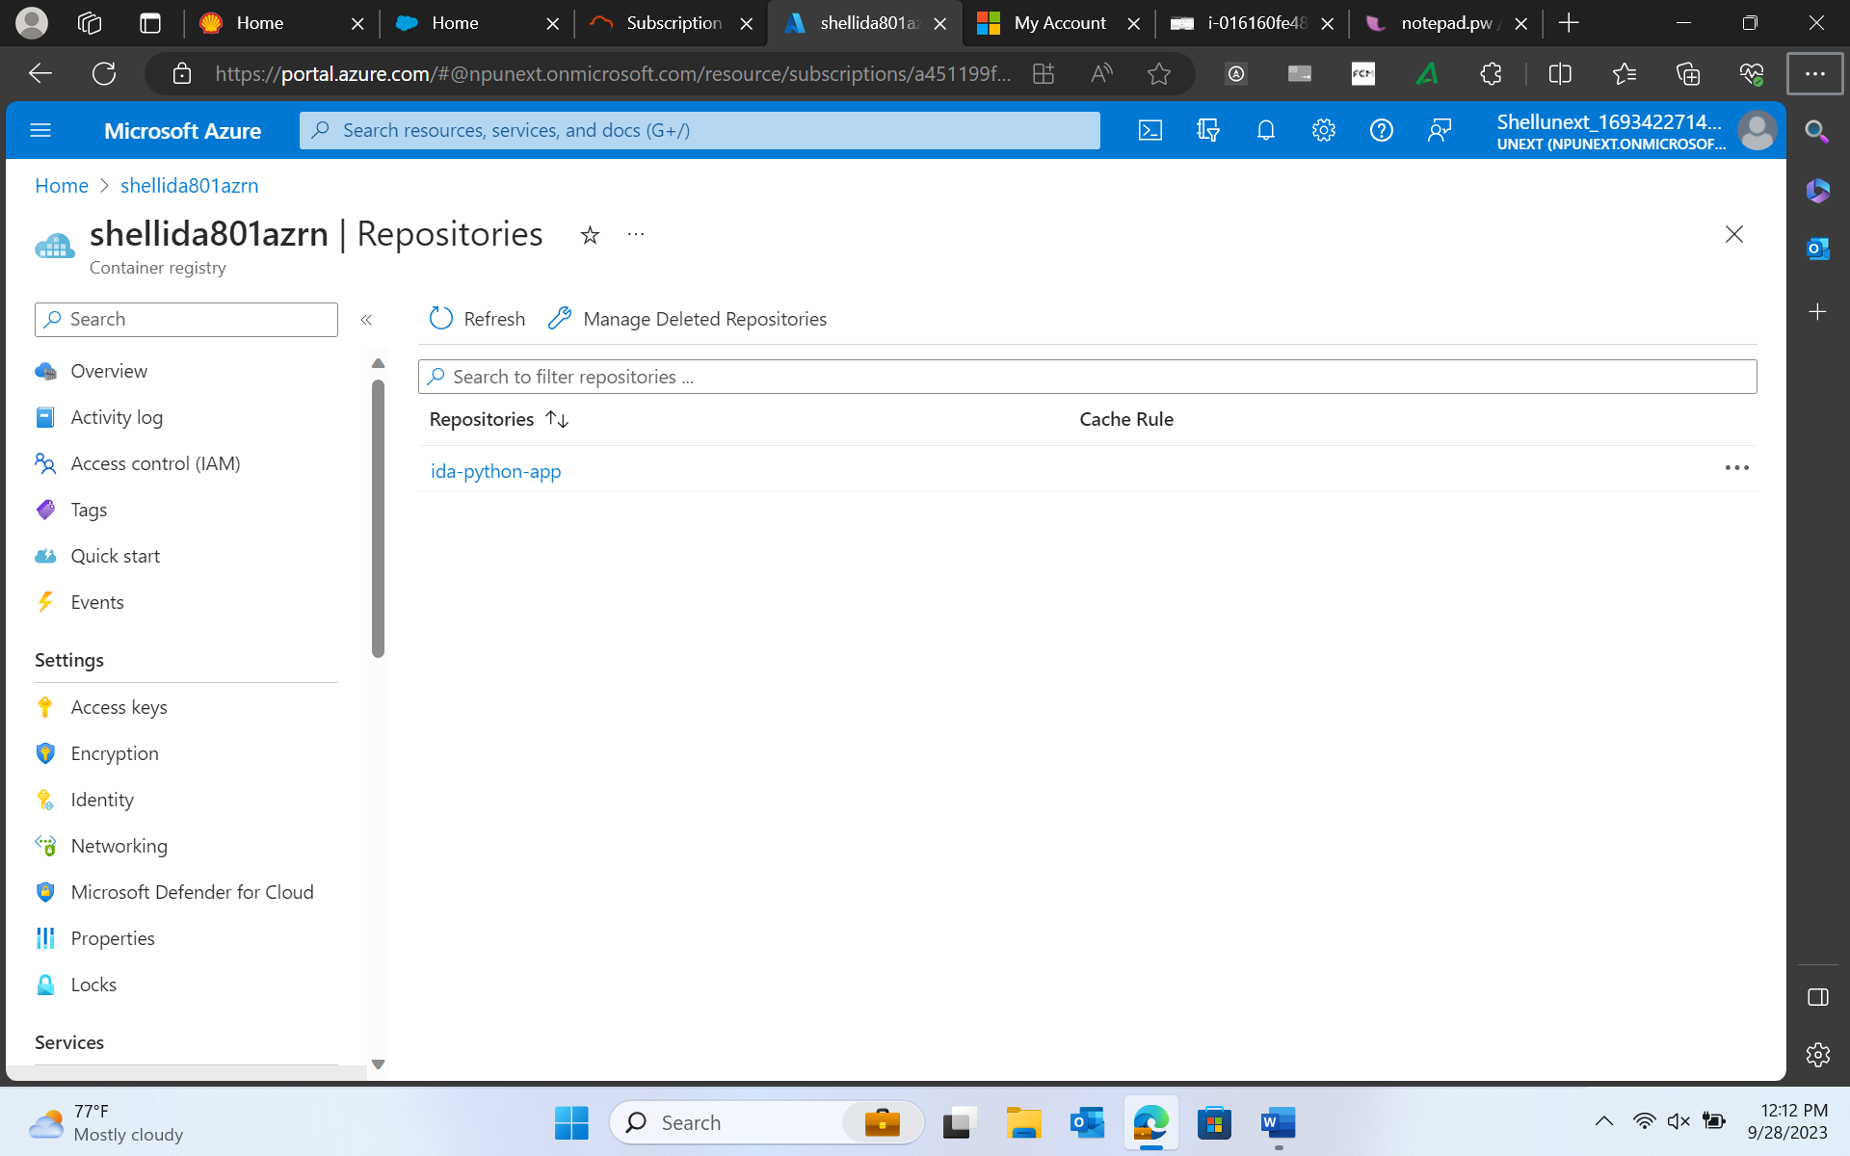
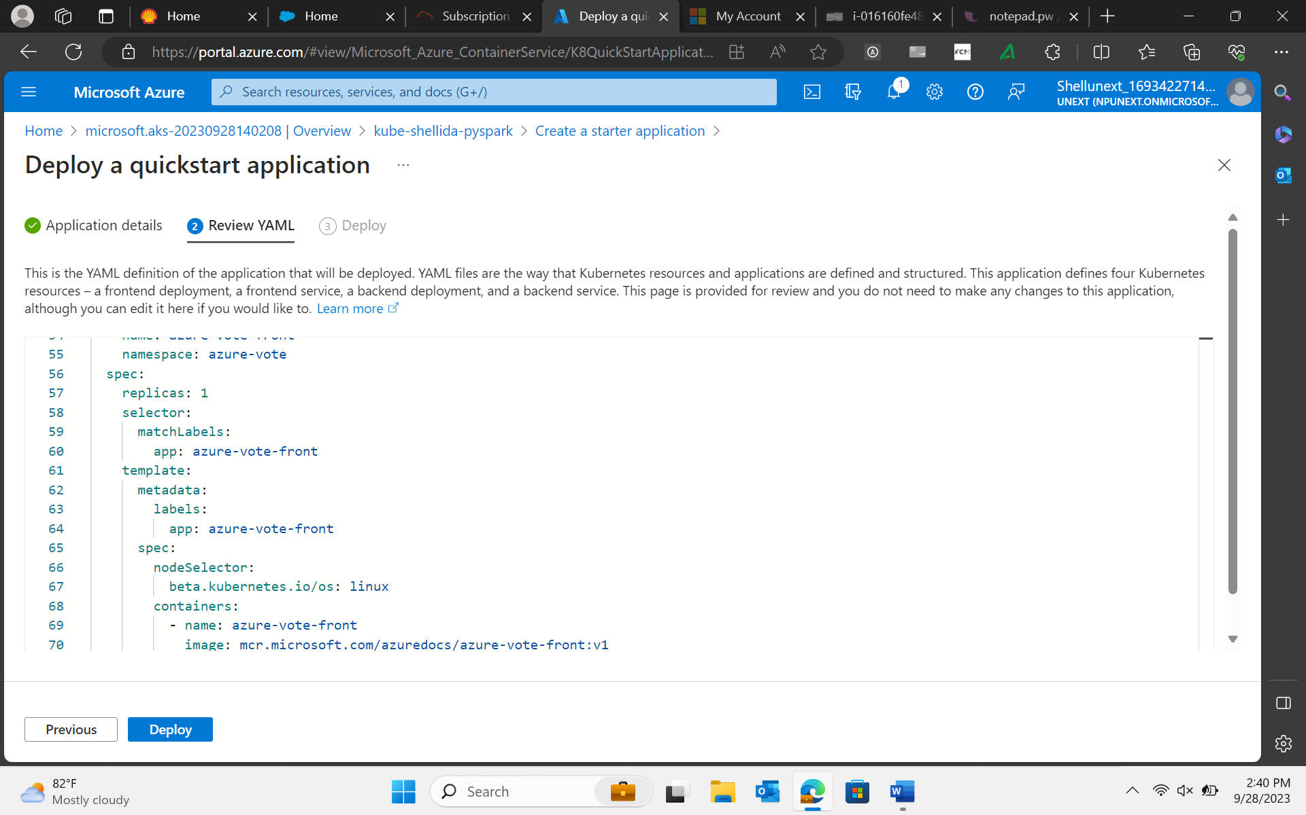
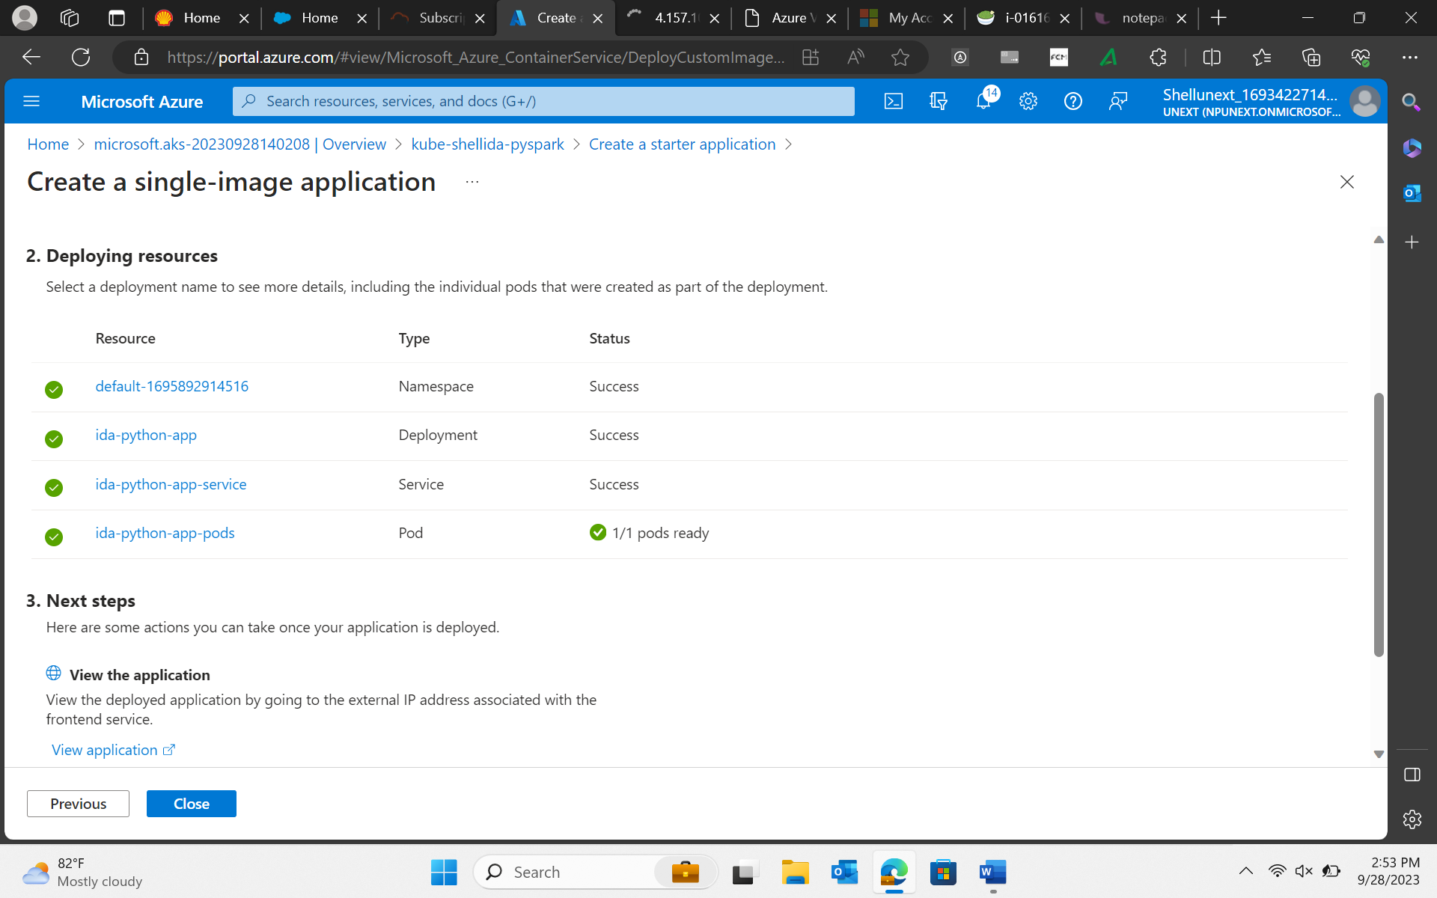
28-Sep-23 (Thursday) – Docker

Slide 9
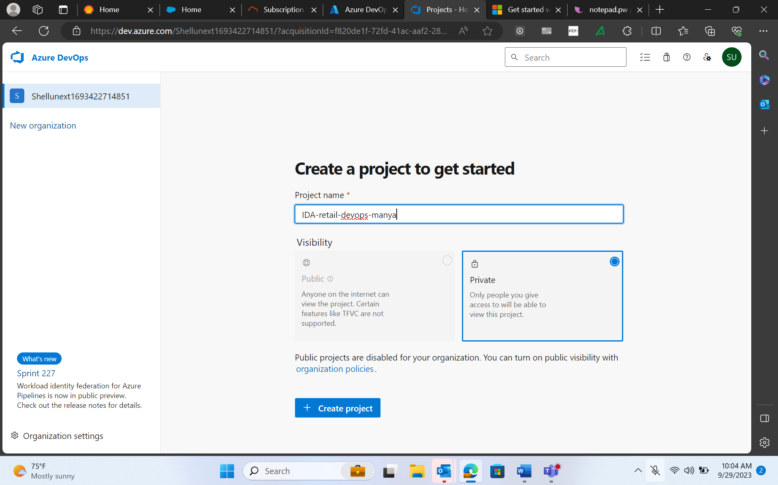
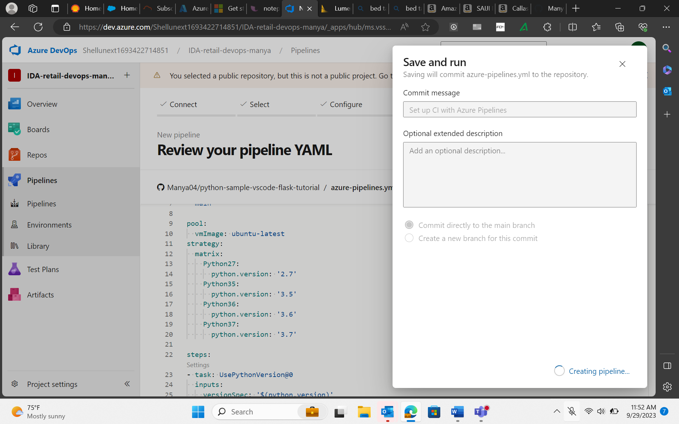
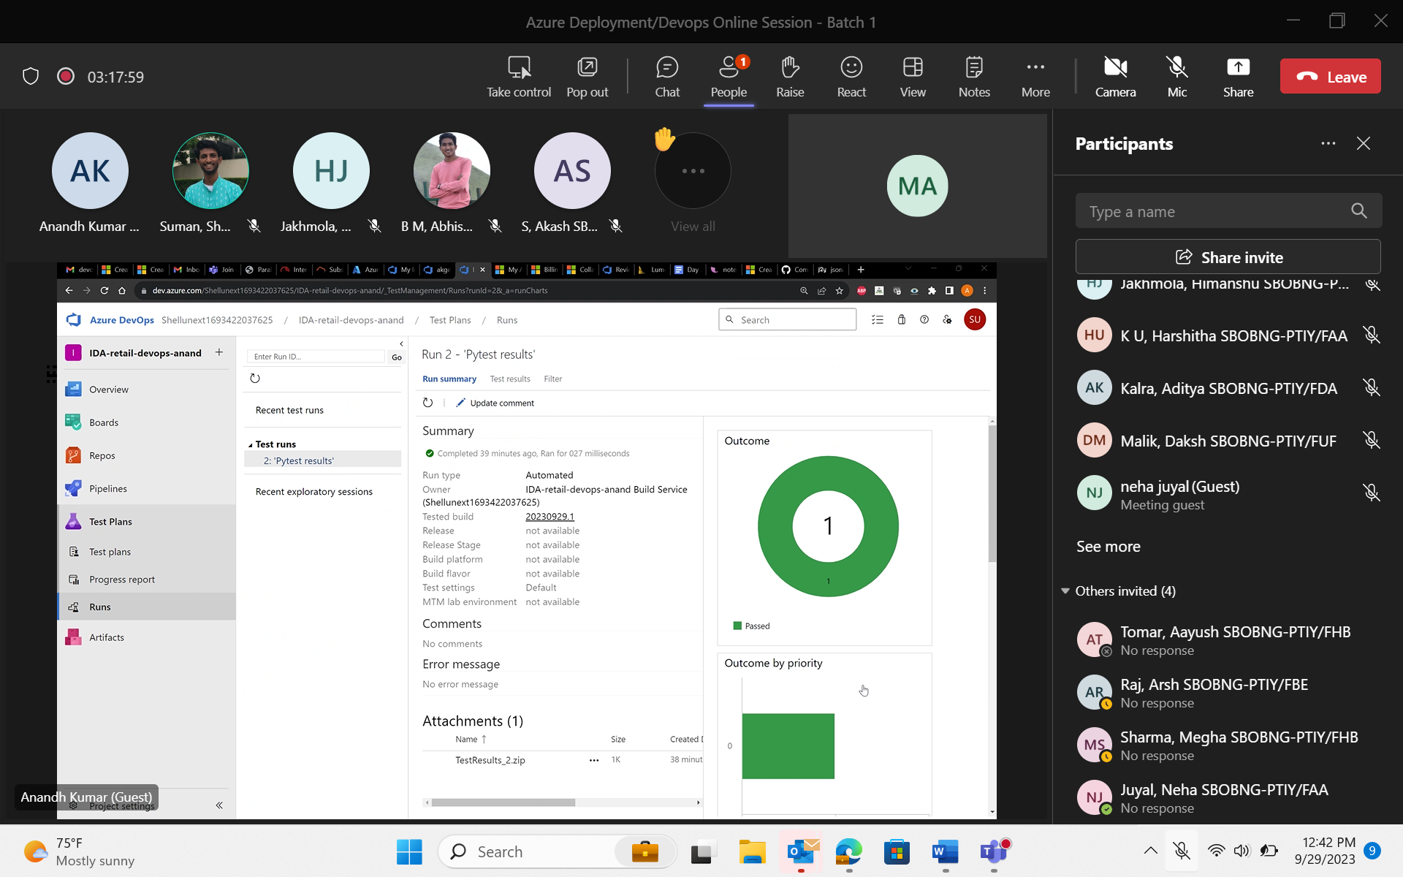
29-Sep-23 (Friday) – Azure Deployment/Devops

